Slide 1

Selected Topics in Computational Intelligence I
Session 09
Advanced Fuzzy Logic

Slide 2
Agenda
Introduction to Fuzzy Logic
Advanced Fuzzy Logic
Fuzzy Interval type-2
Implementation

Slide 3
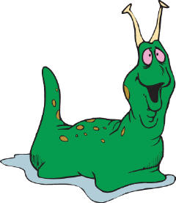



Fuzzy Logic representation
Slowest
For every problem must represent in terms of fuzzy sets.
What are fuzzy sets?
[ 0.0 – 0.25 ]
Slow
[ 0.25 – 0.50 ]
Fast
[ 0.50 – 0.75 ]
Fastest
[ 0.75 – 1.00 ]

Slide 4
Classical Sets
Classical sets contain objects that satisfy precise properties of membership; fuzzy sets contain objects that satisfy imprecise properties of membership, i.e., membership of an object in a fuzzy set can be approximate.
For example, the set of heights from 5 to 7 feet is precise (crisp); the set of heights in the region around 6 feet is imprecise, or fuzzy.

Slide 5
Classical Sets (2)
Define a universe of discourse, X, as a collection of objects all having the same characteristics. The individual elements in the universe X will be denoted as x.
Examples of elements of various universes might be as follows:
The clock speeds of computer CPUs
The operating currents of an electronic motor
The operating temperature of a heat pump (in degrees Celsius)
4. The Richter magnitudes of an earthquake

Slide 6

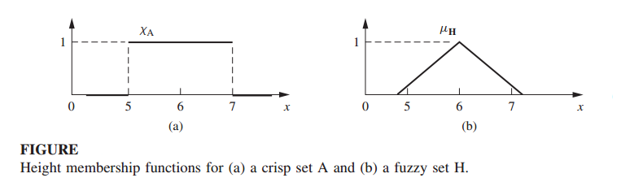
Fuzzy Sets and Membership
For crisp sets, an element x in the universe X is either a member of some crisp set A or not. This binary issue of membership can be represented mathematically with the indicator function
Nilai keanggotaan
Fungsi keanggotaan

Slide 7
Classical Sets
The universe of discourse is the universe of all available information on a given problem. Figure below shows an abstraction of a universe of discourse, say X, and a crisp (classical) set A somewhere in this universe.
A classical set is defined by crisp boundaries, that is, there is no uncertainty in the prescription or location of the boundaries of the set, where the boundary of crisp set A is an unambiguous line.

Slide 8
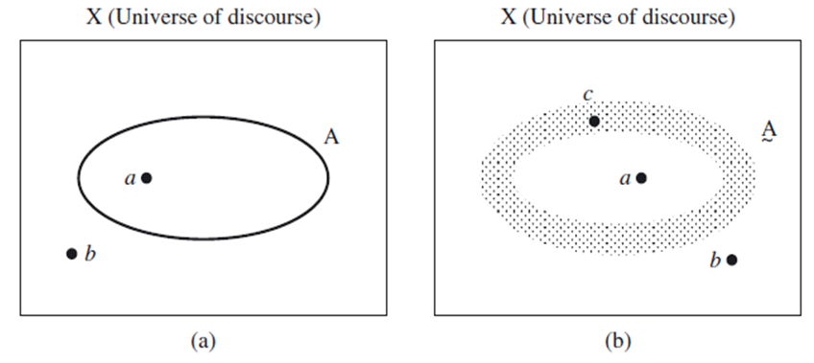
Classical Sets (con’t)
Crisp set boundary (a) and fuzzy set boundary(b)

Slide 9
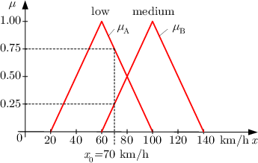
fuzzification
The fuzzification comprises the process of transforming crisp values into grades of membership for linguistic terms of fuzzy sets. The membership function is used to associate a grade to each linguistic term.

Slide 10
example
fuzzification
For the fuzzification of the car speed value the two membership functions uA and uB. The given speed value of x₀=70km/h belongs with a grade of u_{A}(x_{o})=0.75 to the fuzzy set ``low'' and with a grade of to the fuzzy set ``medium''.

Slide 11
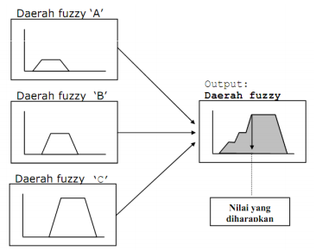
Defuzzification
Defuzzification is the process of producing a quantifiable result in fuzzy logic, given fuzzy sets and corresponding membership degrees. It is typically needed in fuzzy control systems.

Slide 12
Cardinality
The total number of elements in a universe X is called its cardinal number; denoted n_{x}, where x again is a label for individual elements in the universe.

Slide 13
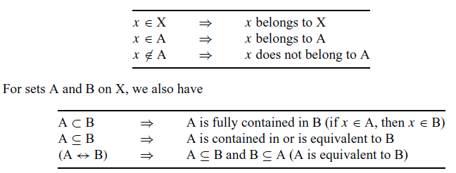
Cardinality (con’t)
For crisp sets A and B consisting of collections of some elements in X, the following notation is defined:
We define the null set , Ø, as the set containing no elements, and the whole set, X, as the set of all elements in the universe.

Slide 14
Exercise
Example : We have a universe composed of three elements, X = {a, b, c}, so the cardinal number is n_{x} = 3. The power set is
P(X) = {Ø, {a}, {b}, {c}, {a, b}, {a, c}, {b, c}, {a, b, c}}.
The cardinality of the power set, denoted n_{p(X}), is found as n_{P(X)} = 2^{nX} = 2³ = 8.
Note that if the cardinality of the universe is infinite, then the cardinality of the power set is also infinity, that is,
n_{X} =∞⇒n_{P(X)} =∞.

Slide 15
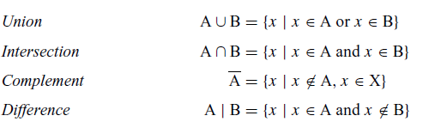
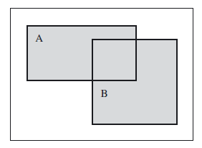
Operation on Classical Sets
Let A and B be two sets on the universe X. The union between the two sets, denoted A ∪ B, represents all those elements in the universe that reside in (or belong to) the set A, the set B, or both sets A and B.

Slide 16
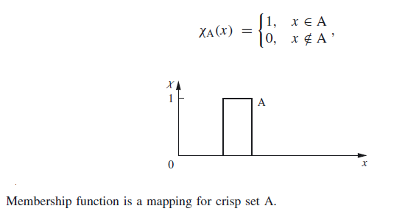
Mapping of Classical Sets
Mapping is an important concept in relating set-theoretic forms to function-theoretic representations of information.
If an element x is contained in X and corresponds to an element y contained in Y, it is generally termed a mapping from X to Y, or f: X → Y.

Slide 17
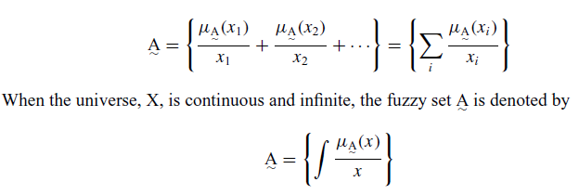
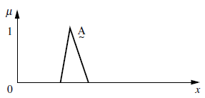
Fuzzy Sets
A notation convention for fuzzy sets when the universe of discourse, X, is discrete and finite, is as follows for a fuzzy set

Slide 18
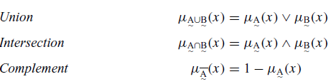
Fuzzy Sets Operations
Define three fuzzy sets , , and on the universe X. For a given element x of the universe, the following function-theoretic operations for the set-theoretic operations of union, intersection, and complement

Slide 19
Fuzzy Sets Theory
Classical Set vs Fuzzy set
Membership value
Membership value
1
1
0
0
175
Height(cm)
175
Height(cm)
Universe of discourse

Slide 20
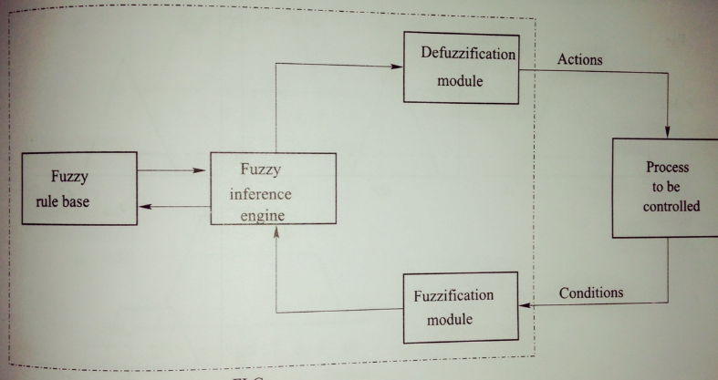
Fuzzy Logic Controller
Consist of 4 modules. The condition (antecedent) and action (consequent) variables need to control a process.

Slide 21
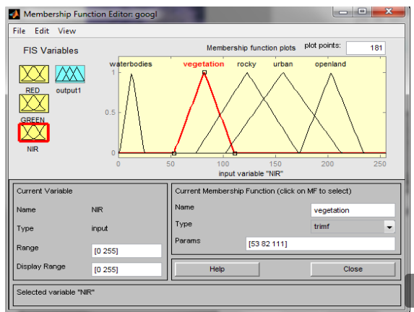
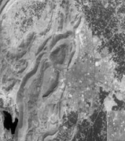
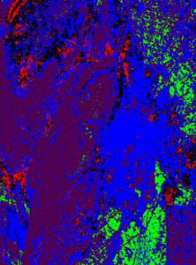
Classification
The intent of the classification process is to categorize all pixels in a digital image into one of several land cover classes, or "themes”.
fuzzy inference system is developed for classifying the satellite image.

Slide 22
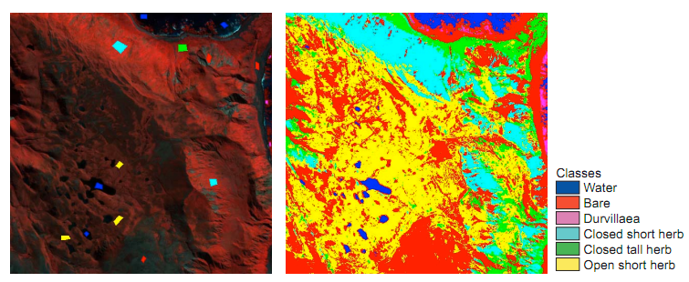
Image Classification
For, example the rule are:
IF (GREEN is mf1) AND (RED is mf1) AND (NIR is mf1)
THEN (class is water)
IF (GREEN is mf2) AND (RED is mf2) AND (NIR is mf2)
THEN (class is urban)
IF (GREEN is mf3) AND (RED is mf3) AND (NIR is mf3)
THEN (class is vegetation)

Slide 23
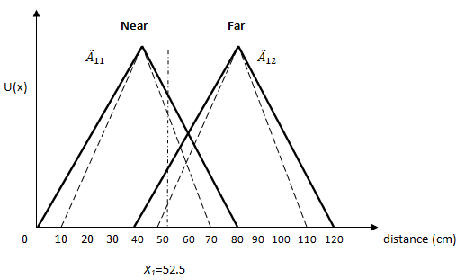
Interval Type 2 Fuzzy Logic
Interval Type-2 Fuzzy Logic Controller is a controller that ideal for many application because it able to handles the uncertainties.
Interval type-2 for obstacle avoidance in robot

Slide 24
References
Adries P. Engelbrect. (2007), Computational Intelligence An Introduction. 2nd ed. John Wiley & Sons. USA.
Negnevitsky M(2005) Artificial Intelligence: A Guide to Intelligent Systems, 2nd Edition.
http://www.mathworks.com/products/fuzzy-logic/

Slide 25
Thank You

